Slide 1
Mid Semester Project
Submitted to : Mrs. Nitika Goenka

Slide 2
Team Members :-
Kush Sharma Roll No- 29
Love Sharma Roll No- 32
Abhinav Sharma Roll No-02

Slide 3
Site :www.udacity.com

Slide 4
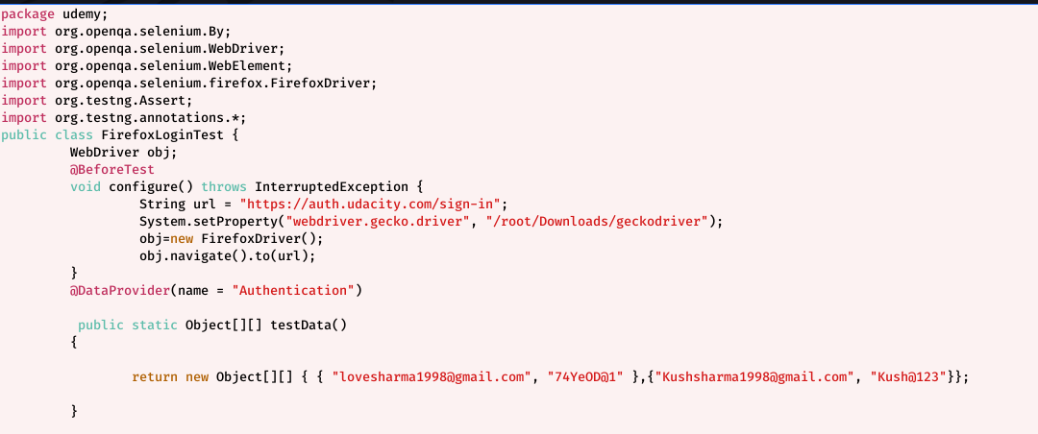
Data Providers with Xpath and Assertion

Slide 5
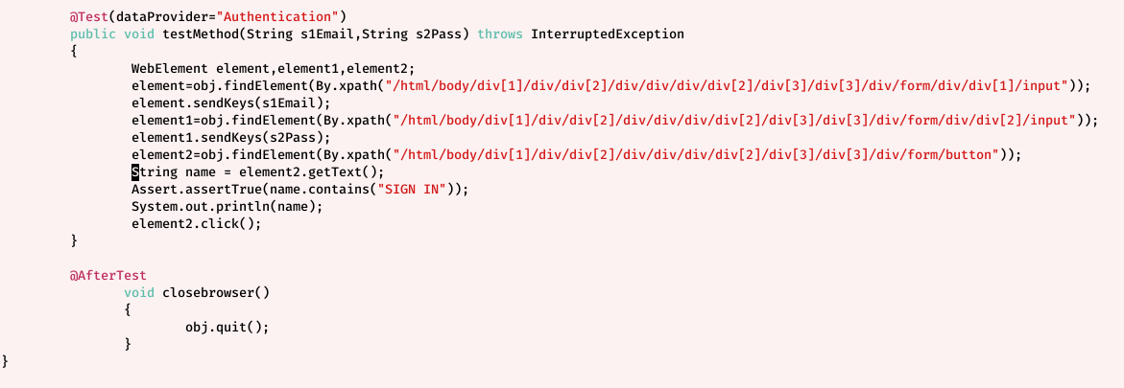

Slide 6
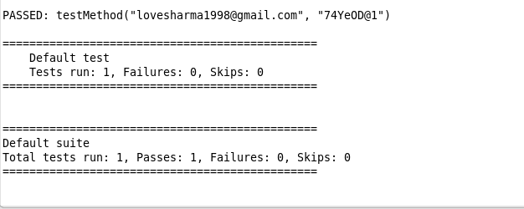
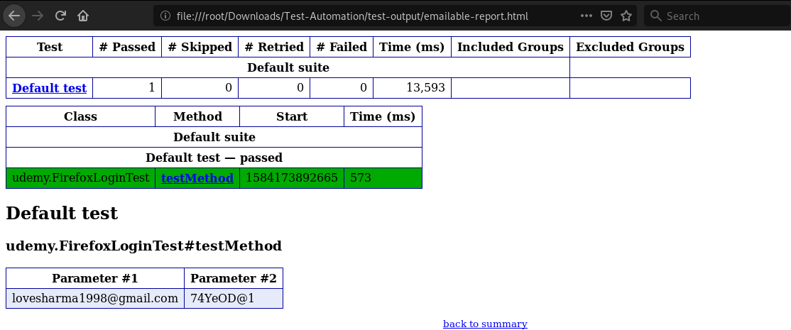
Output -

Slide 7
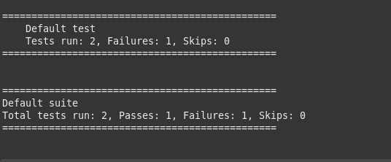
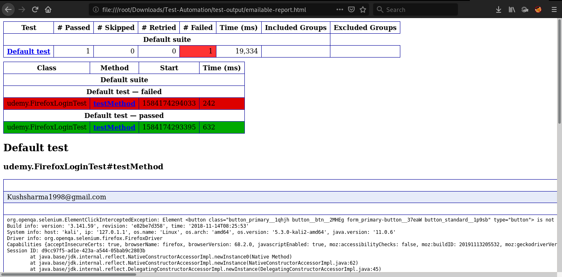

Slide 8
Code Description
configure() function for setting up the gecko driver and opening it the browser with it.
DataProvider for setting up the input to be inserted in the fields.
testMethod() function that is taking the input from the DataProvider and the result report is generated against it.
closebrowser() with @AfterTest annotations which indicates that this function would be executed last. This function would be close the browser.

Slide 9
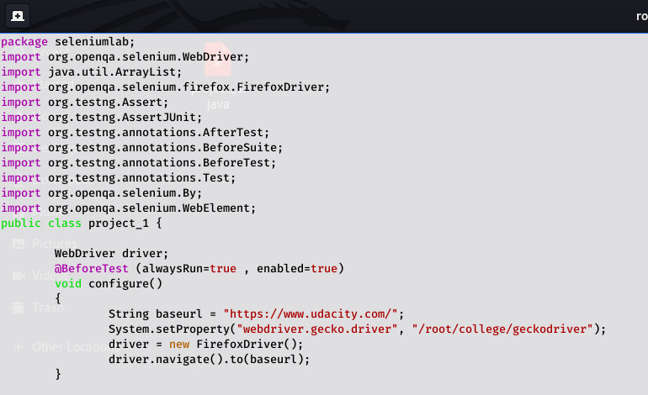
Login, Signup,Product Search with Assertion

Slide 10
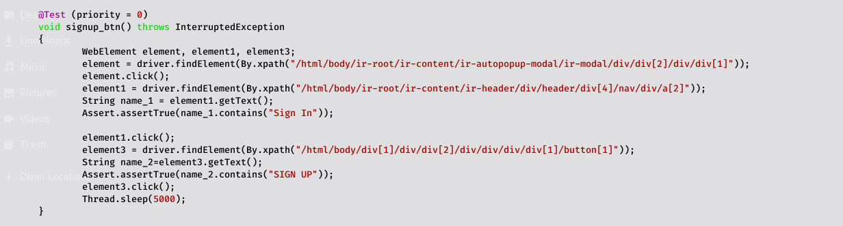

Slide 11
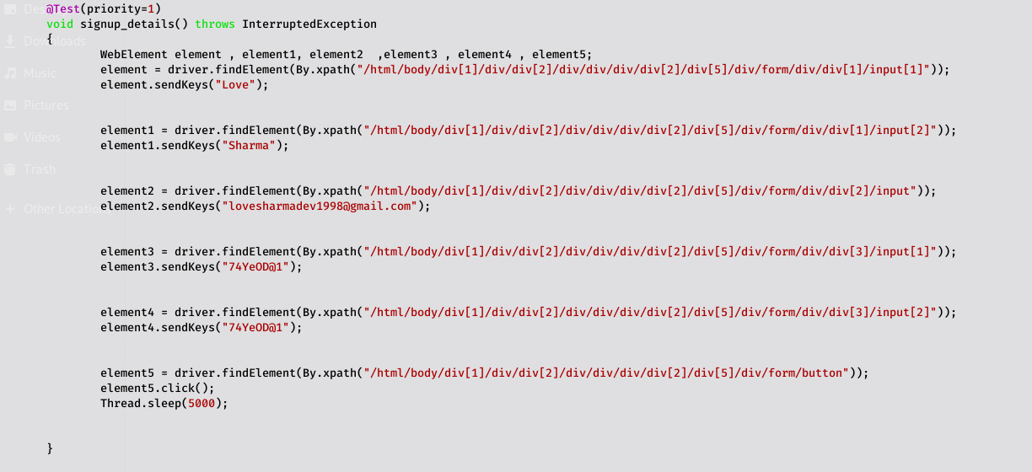

Slide 12
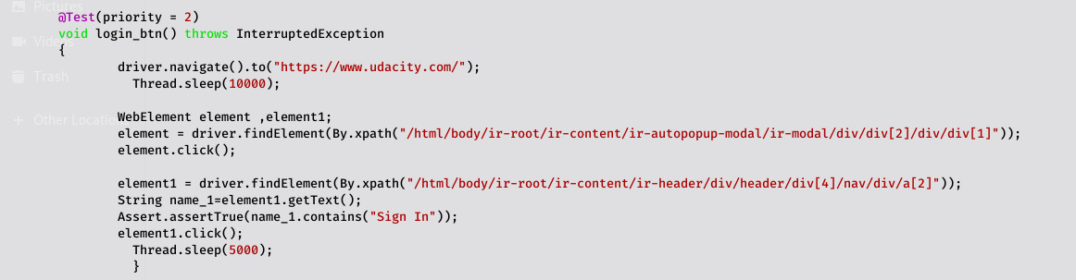

Slide 13
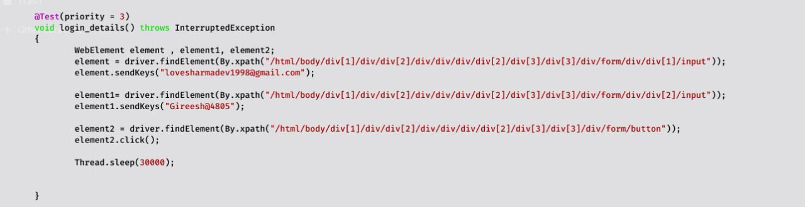

Slide 14
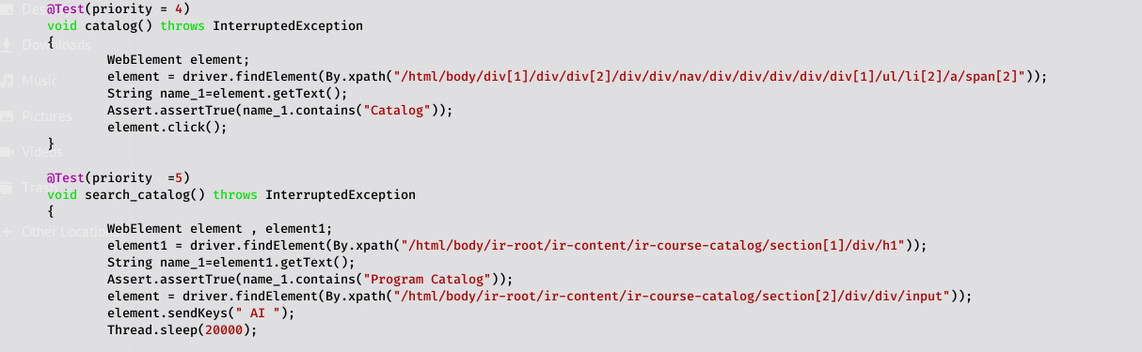
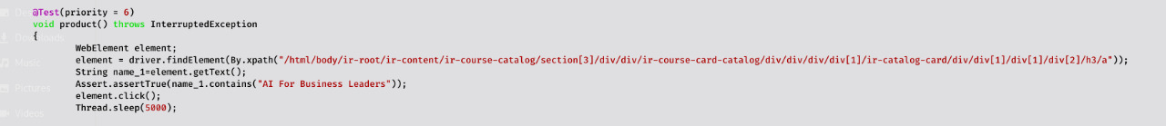

Slide 15
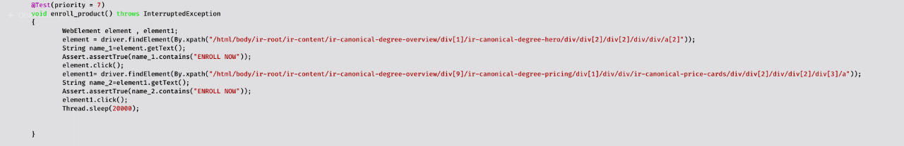
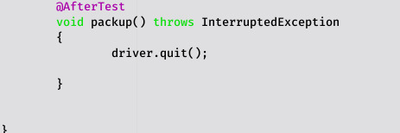

Slide 16
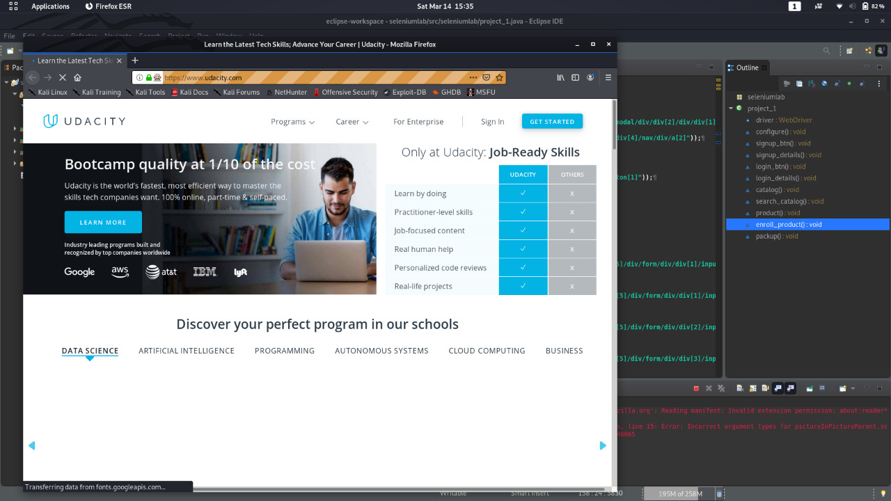
Output

Slide 17
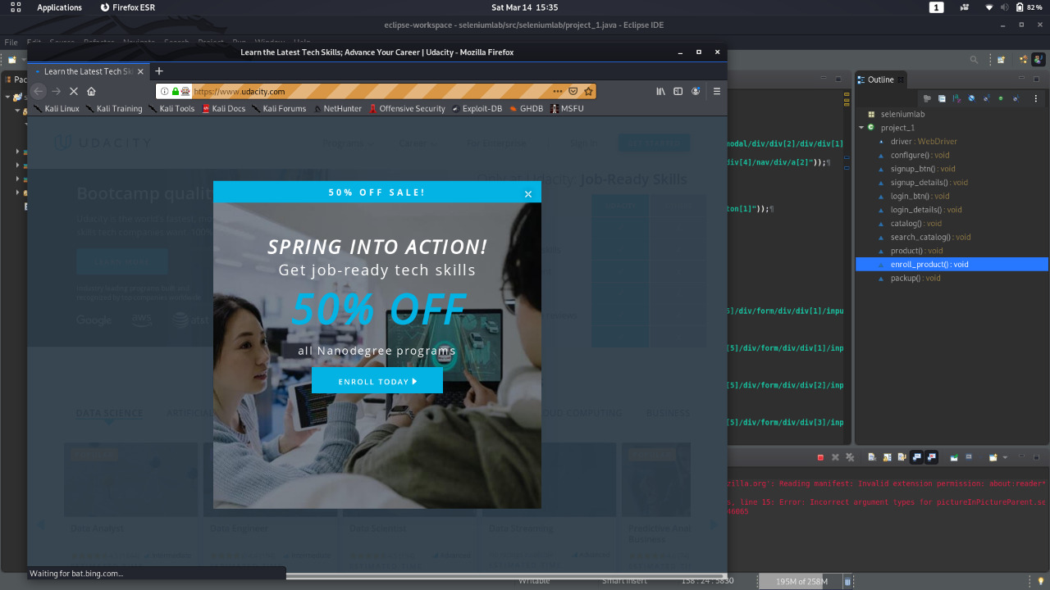
Dealing with the pop-up and removing it by specifying the xpath of it

Slide 18
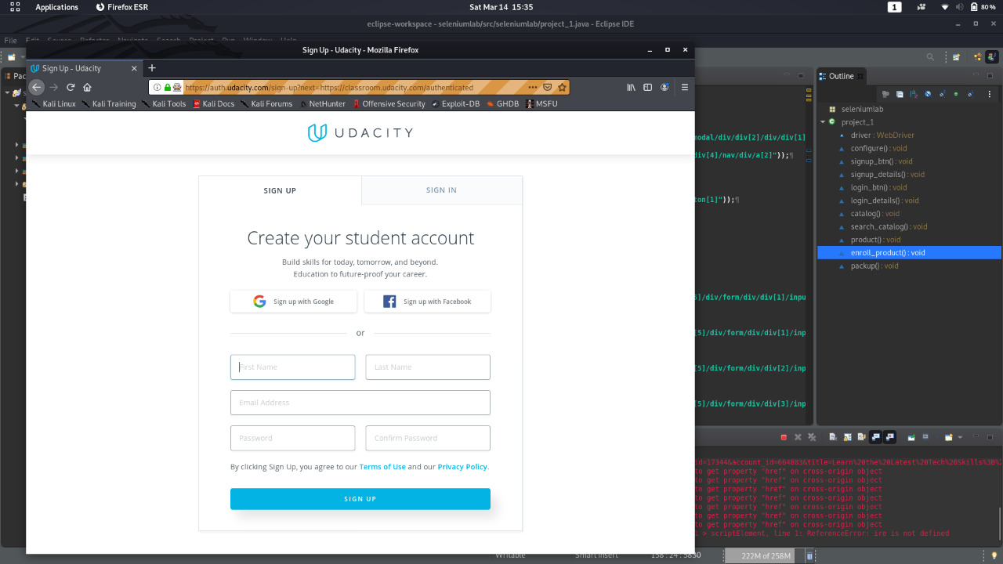
Filling the form by specifying the Xpath and Signing-Up using Assertion

Slide 19
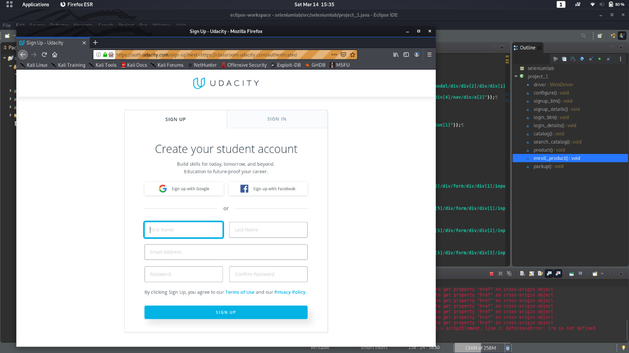
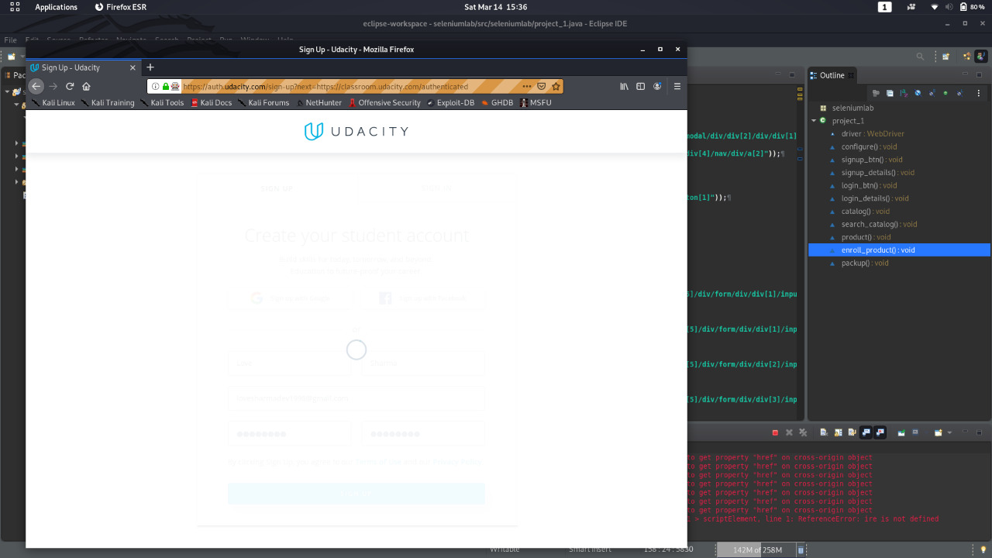

Slide 20
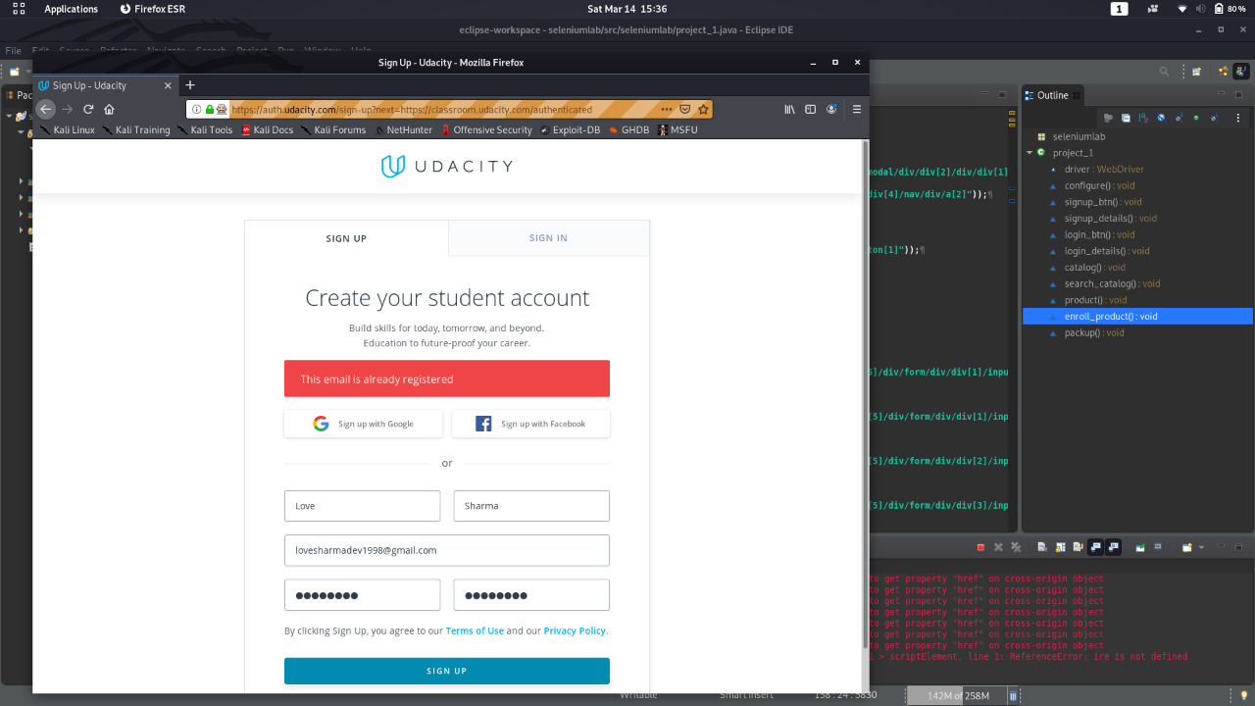
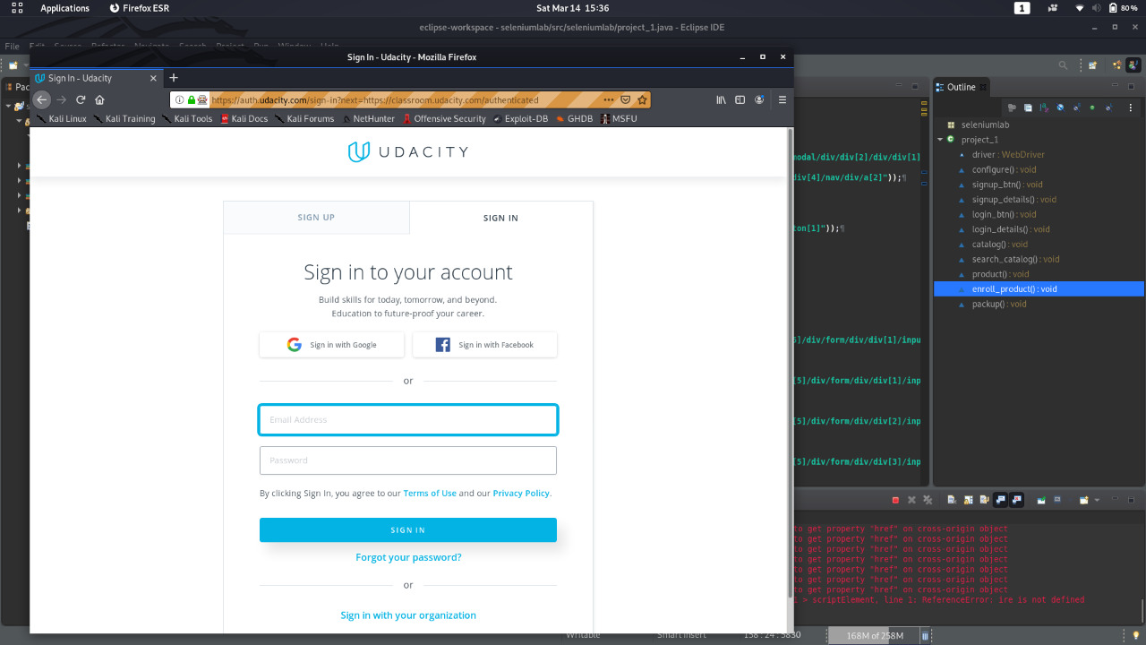

Slide 21
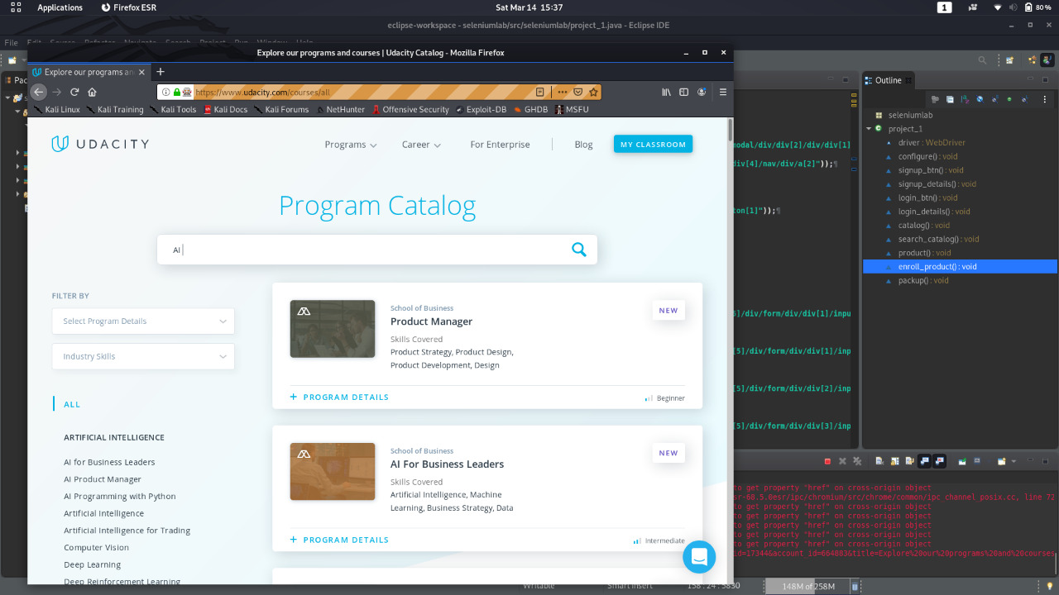
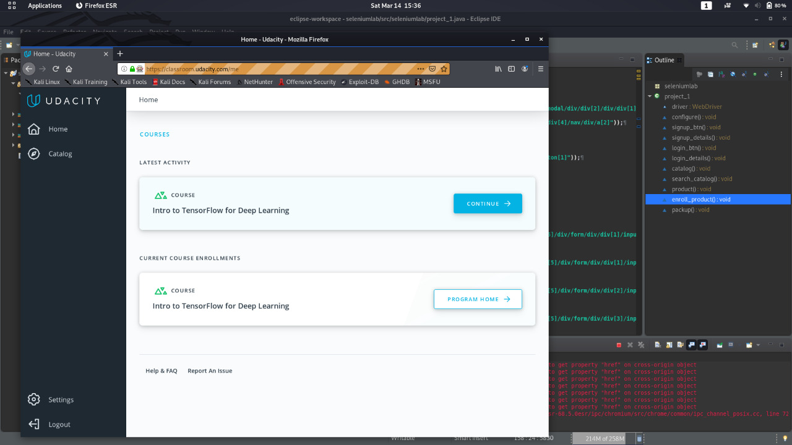

Slide 23
Code Description
1.Void confugure()
This function deals with setting up the driver and creating initializing the object of firefox driver.
2. Void signup_bt()
This function deals with testing the sign up button. It creates three web elements for reaching to the sign up page. This function is basically dealing with clicking of sign up button and checking if button is present or not.

Slide 24
3. Void signup_details()
This function deals with inputting the values on the sign up page and checking if sign up functionality is properly working or not. This function has six web elements that deals with six input fields on the sign up page.
4. Void login_btn()
This function deals with testing the login or sign in button. This function have two web elements to reach up to the login button. On reaching login button it clicks on it and checks if it is properly rendered or not.

Slide 25
5. Void login_details()
This function deals with inputting the values on the sign in page and checking if sign in functionality is properly working or not. This function has two web elements that deals with two input fields on the sign in page.
6. Void catalog()
This function deals with checking the functionality of the Udacity dashboard. It click on one element of the dashboard named catalog. This function have two web elements to click on the catalog option and to check if catalog is correctly rendered on screen or not.

Slide 26
7. Void product()
This function deals with searching one product and then checking if it is available or not and then clicking on the product. It also check if product is correctly named or not.
8. Void enroll_product()
This function deals with checking if for particular course the enroll option is available or not. If it is available it is being clicked.
9.Void packup()
This function simply deals with closing the driver that was initialized in viod configure function.

Slide 27
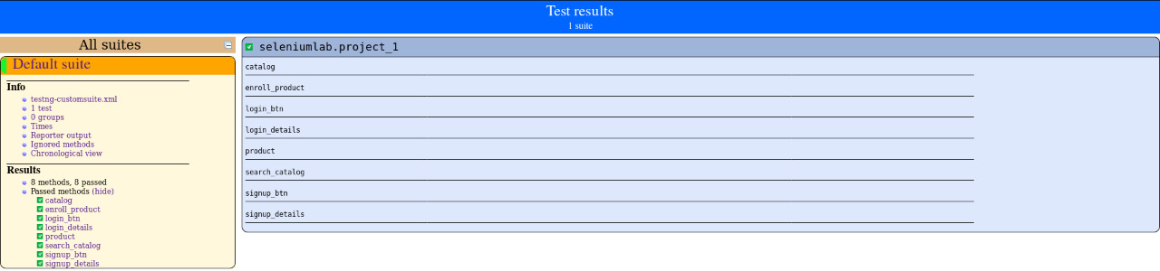
HTML Output

Slide 28
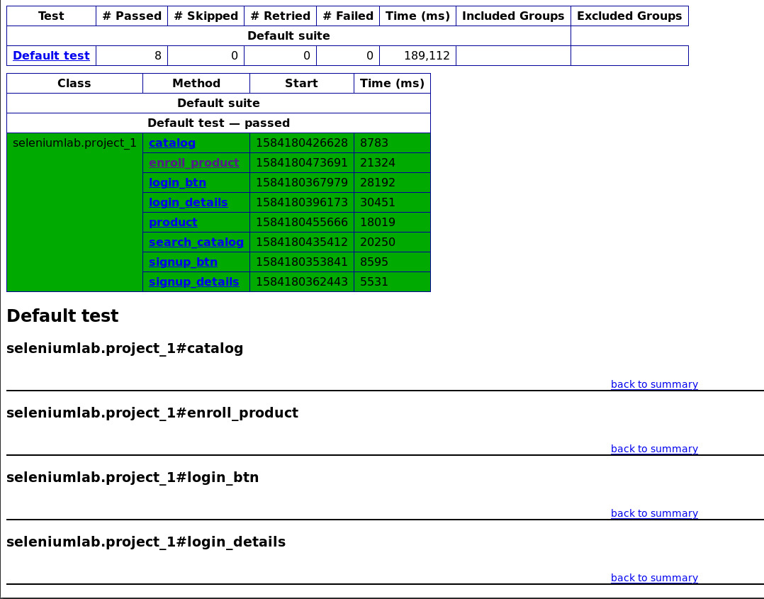

Slide 29
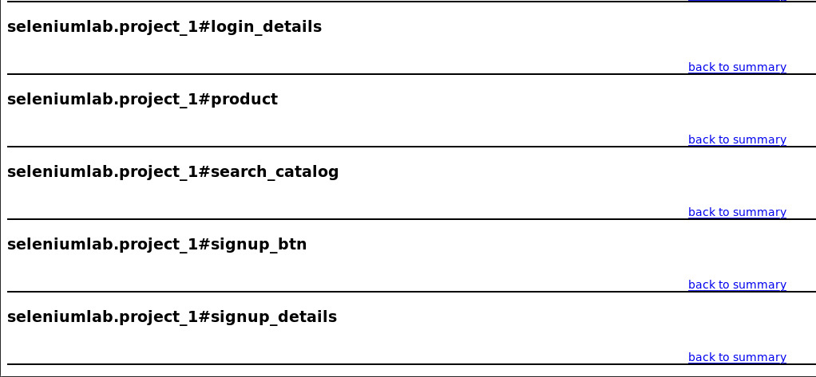

Slide 30
Search product tests using cssSelector

Slide 31
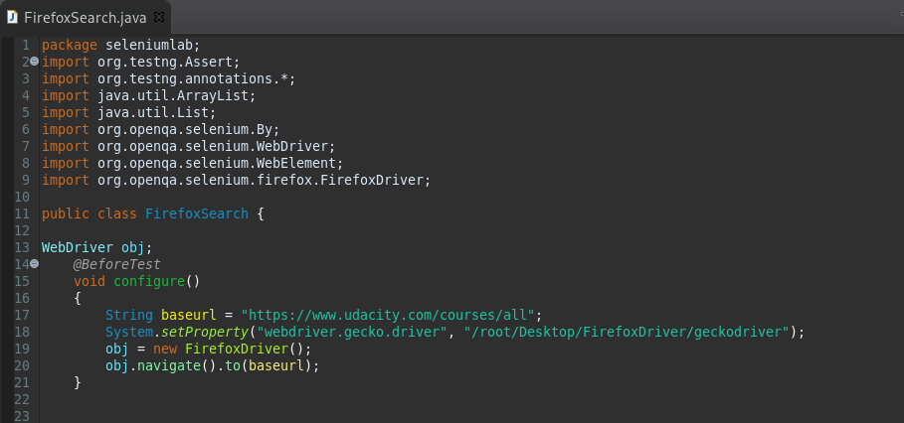
Program to test the search functionalities of the website
Firstly, configuring the gecko driver for testing.

Slide 32
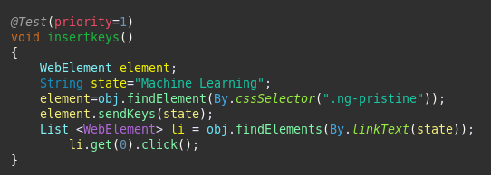
insertkeys() function
This function will help in running the test case to see if the search courses functionality is correctly working or not.

Slide 33
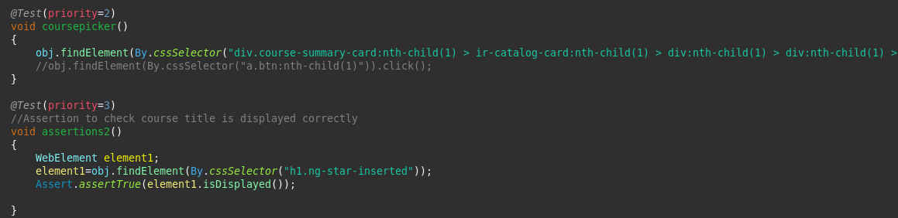
coursepicker() and assertion2() function
The coursepicker() function will help to test the functionality of testing a particular course from the catalog and assertion2() will help to test whether the course title in been correctly displayed on the website or not.

Slide 34
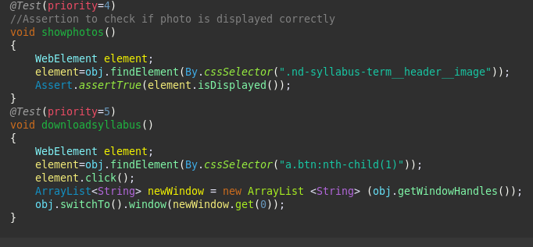
showphotos() and downloadsyllabus() function
The showphotos() will check for assertion whether the course photo is been correctly displayed on the website or not and the downloadsyllabus() will see whether the syllabus downloading prompt is being loaded or not

Slide 35
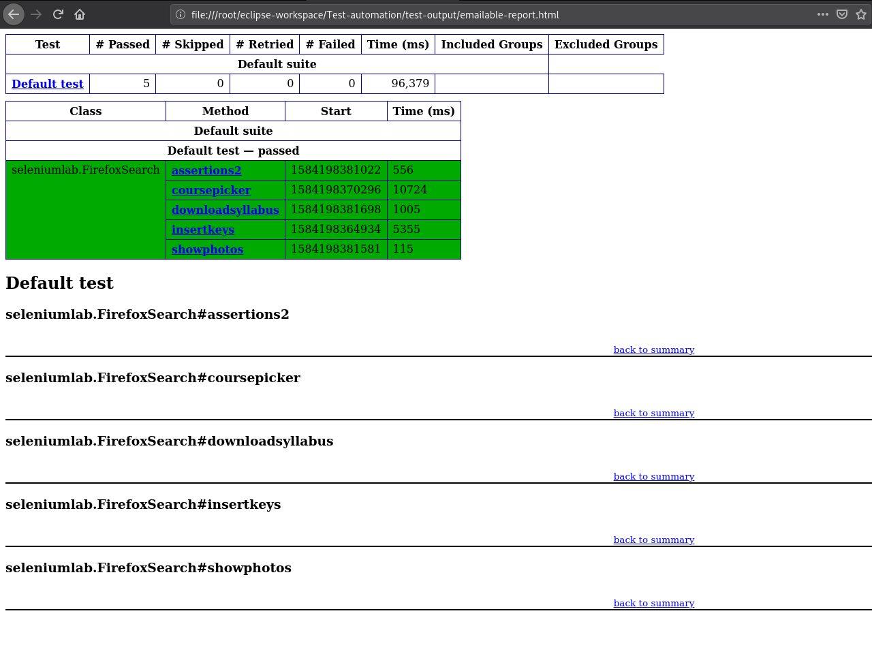
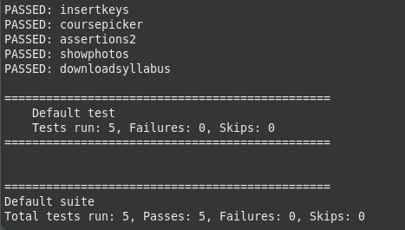
Outputs
The reports for the above tests are shown below:

Slide 36
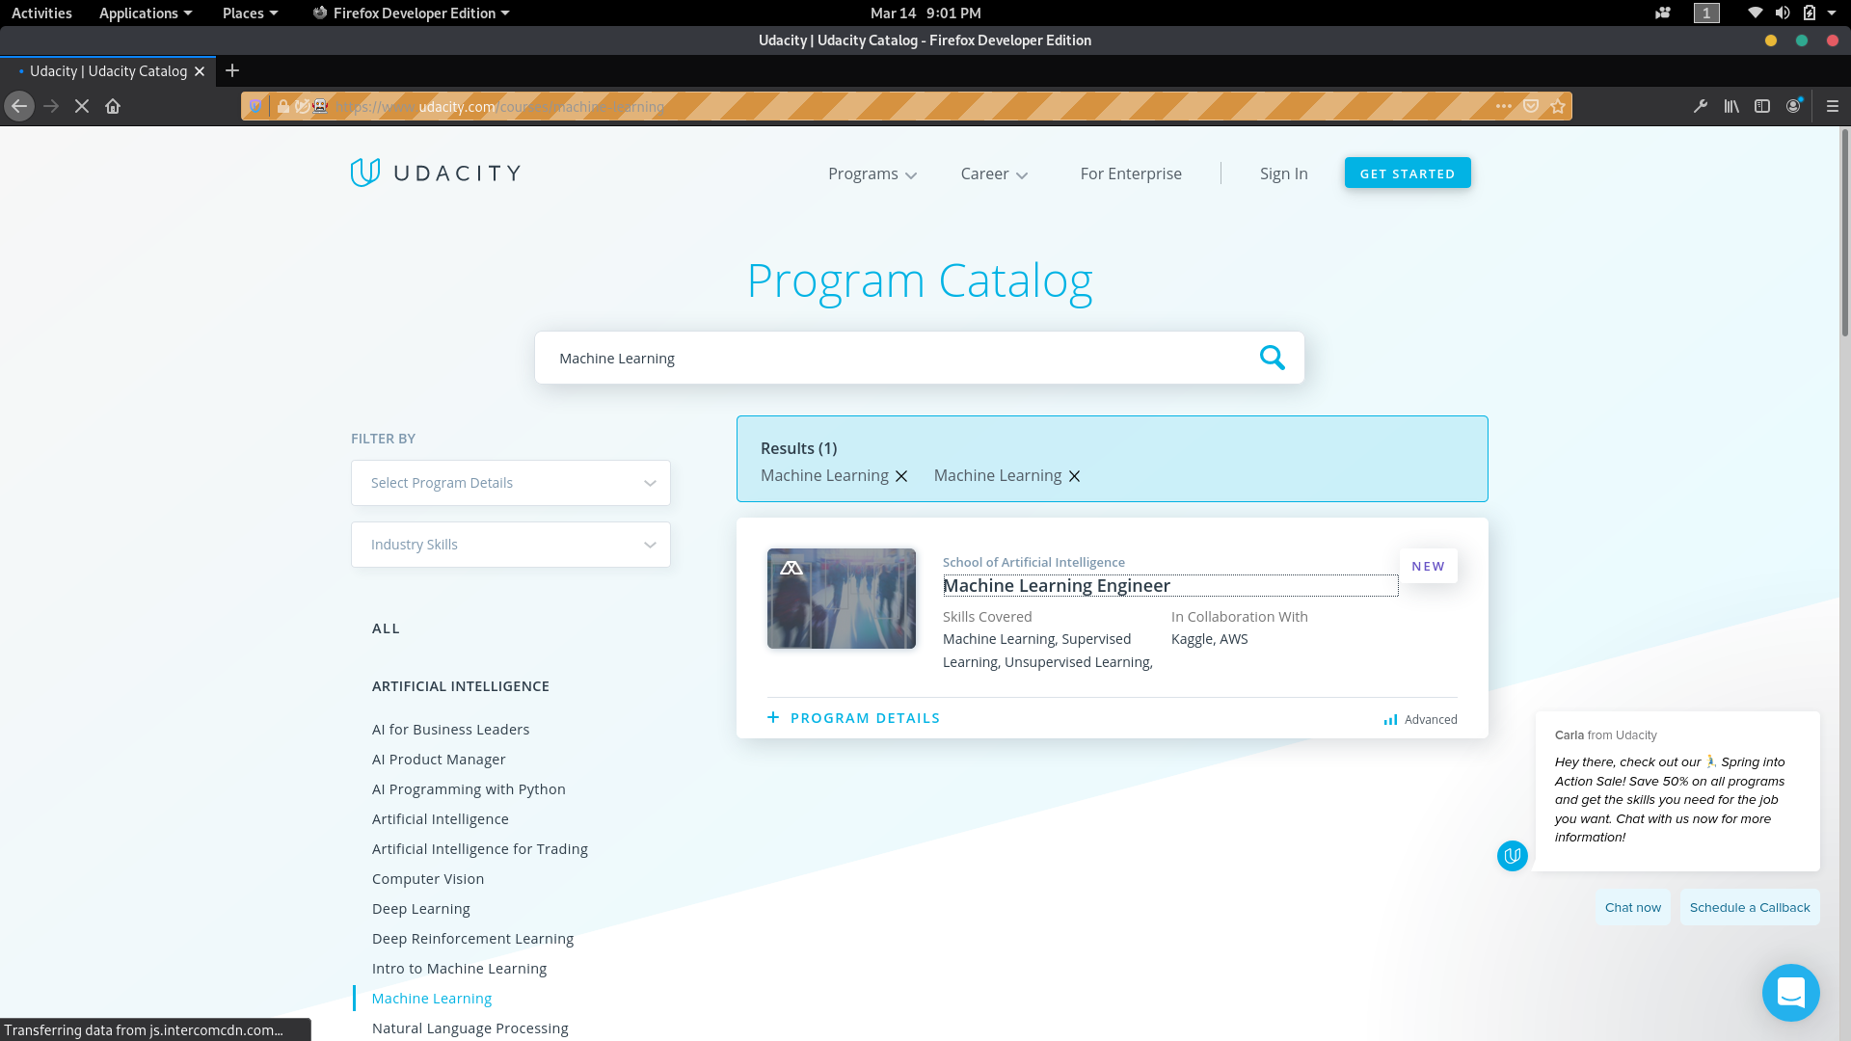

Slide 37
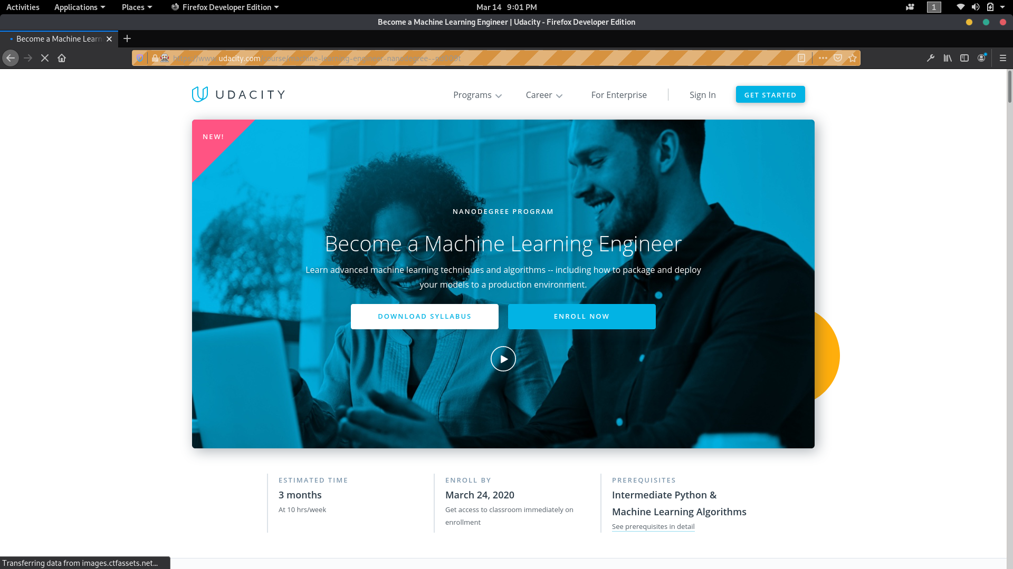

Slide 38
Login tests using cssSelector

Slide 39
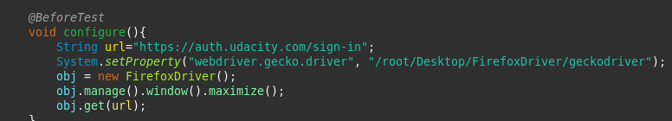
Firstly, configuring the gecko driver for testing

Slide 40
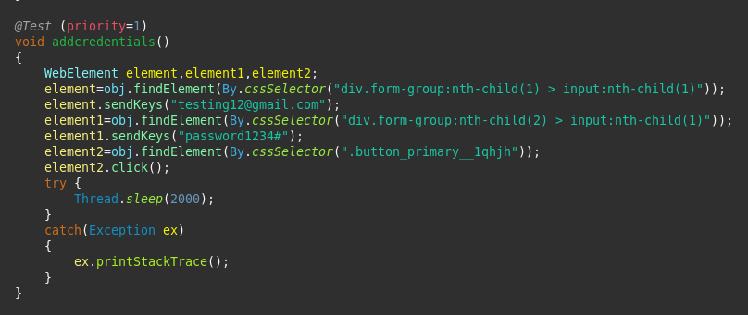
addcredentials() function
This function would test whether the credentials are being passed correctly and are the user is being authenticated properly or not.

Slide 41
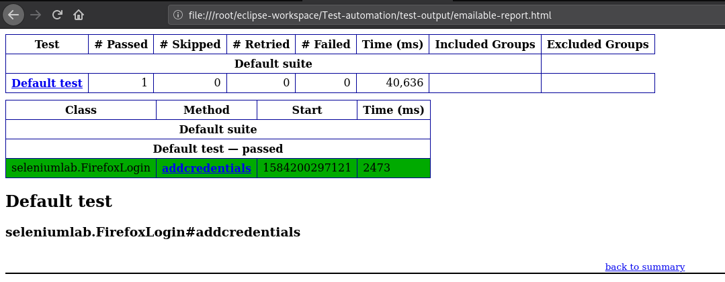
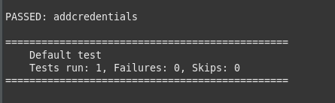
Outputs:

Slide 42
Signup tests using cssSelector

Slide 43
Firstly configuring the gecko driver for testing

Slide 44
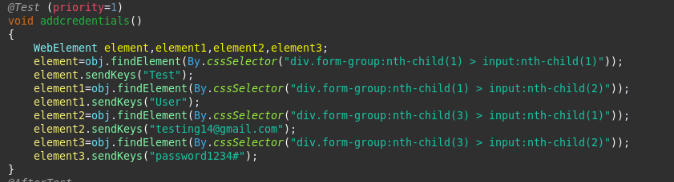
addcredentials() function
This function tests the functionality to enter the details for a user who is trying to register on the website.

Slide 45
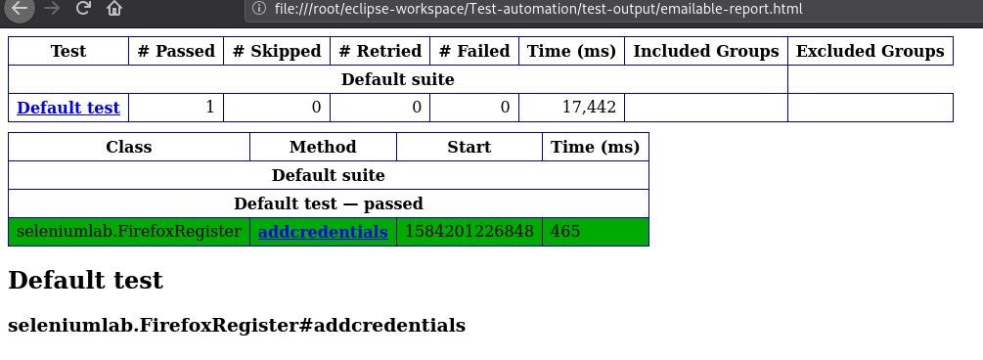
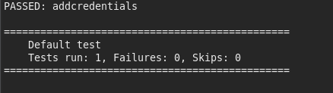
Output:

